Slide 6
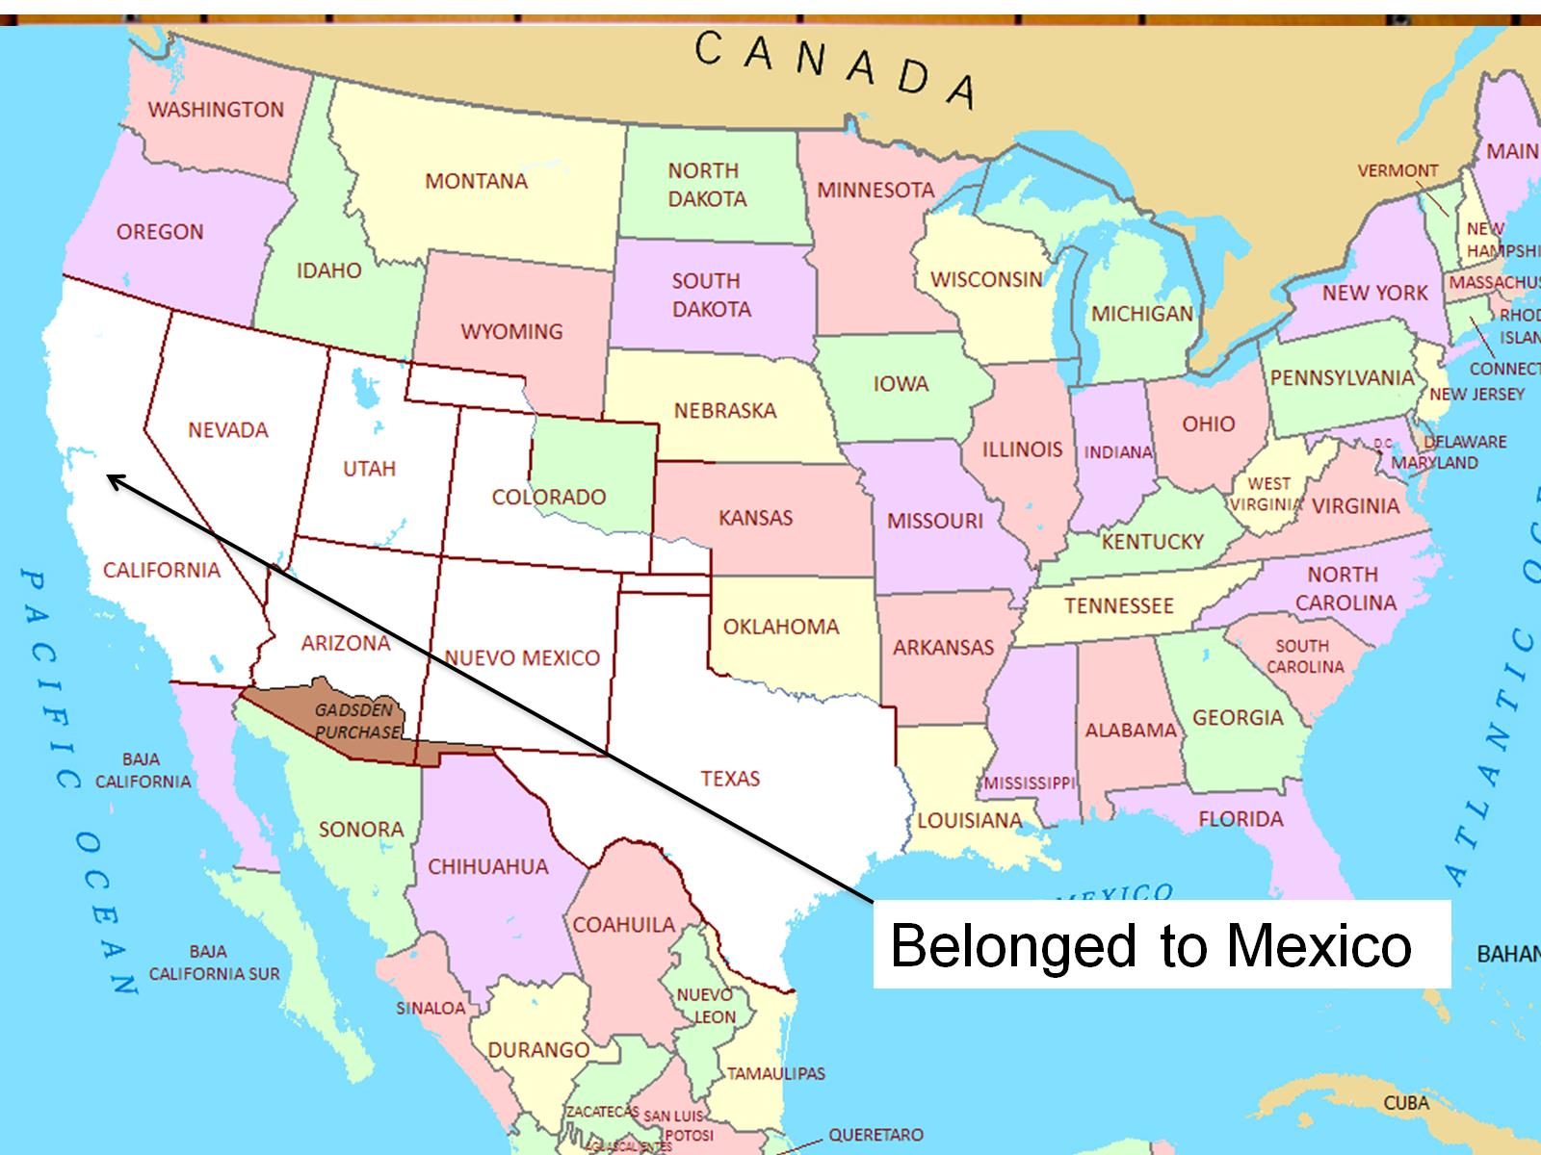

Slide 13
We are Mexican

